Slide 1


Introduction to Angular Learn some of the things!
Nate Lapinski
nathan-lapinski (github)

Slide 2
About me
Full stack dev. Angular. Javascript

Slide 3

About me
Full stack dev. Lots of Angular. Lots of Javascript

Slide 4
Overview

Slide 5
Overview
Learn the basics of Angular 5

Slide 6
Overview
Learn the basics of Angular 5
Code along if you want! https://github.com/nathan-lapinski/learn-angular-catch-pokemon
https://stackblitz.com/github/nathan-lapinski/learn-angular-catch-pokemon/tree/master/APP-Start https://pokeapi.co/

Slide 7
Why learn Angular?

Slide 8
Why learn Angular?
Expressive HTML

Slide 9
Why learn Angular?
//display-pokemon <div *ngIf=”userIsLoggedIn”> <div *ngFor=”let poke of pokemon”> <span>{{poke.name}}</span> <img [src]=”poke.url”> </div> </div>
Expressive HTML

Slide 10
Why learn Angular?
//display-pokemon <div *ngIf=”userIsLoggedIn”> <div *ngFor=”let poke of pokemon”> <span>{{poke.name}}</span> <img [src]=”poke.url”> </div> </div>
Expressive HTML
<h1>Welcome!</h1> <display-pokemon></display-pokemon> <div>... ...

Slide 11
Why learn Angular?
Expressive HTML
Data Binding

Slide 12
Why learn Angular?
<input [(ngModel)]="name" type="text">
<h3>Hi, my name is {{name}}</h3>
export class AppComponent {
name = '';
}
Expressive HTML
Data Binding

Slide 13
Why learn Angular?
<input [(ngModel)]="name" type="text">
<h3>Hi, my name is {{name}}</h3>
export class AppComponent {
name = '';
}
Expressive HTML
Data Binding

Slide 14
Why learn Angular?
Expressive HTML
Data Binding
Strong Library Support

Slide 15
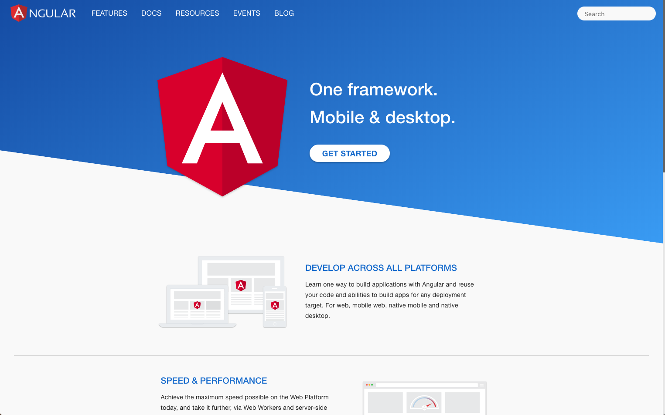
https://angular.io/

Slide 16

Why learn Angular?
Expressive HTML
Data Binding
Strong Library Support

Slide 17

Why learn Angular?
Expressive HTML
Data Binding
Strong Library Support

Slide 18
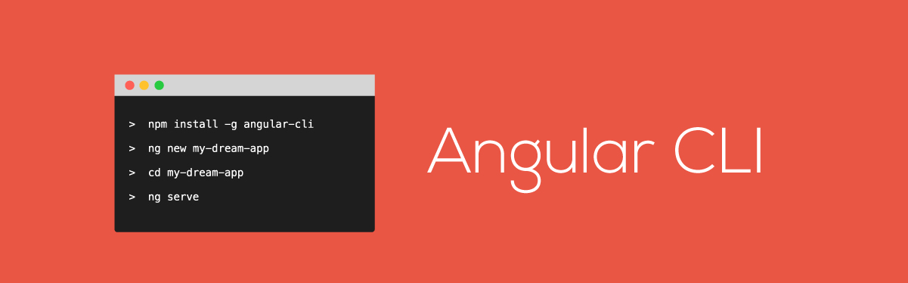
Why learn Angular?
Expressive HTML
Data Binding
Strong Library Support

Slide 19

Why learn Angular?
Expressive HTML
Data Binding
Strong Library Support

Slide 20
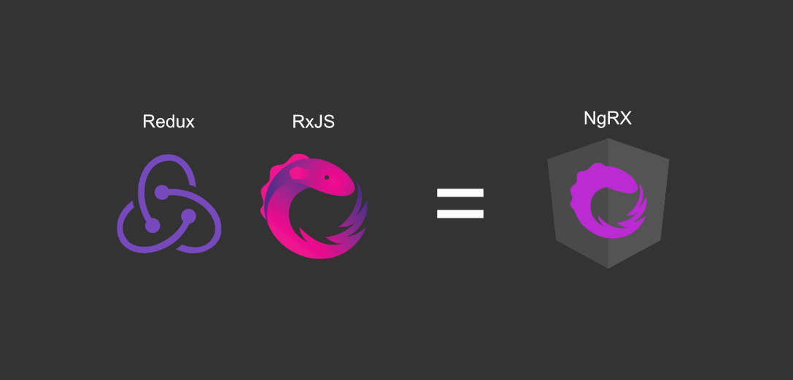

Slide 21
A Tale of Two Angulars

Slide 22

A Tale of Two Angulars
Angular 1.x is referred to as AngularJS

Slide 23



A Tale of Two Angulars
Angular 1.x is referred to as AngularJS
Angular 2+ is simply referred to as Angular

Slide 24
A Tale of Two Angulars
Angular 1.x is referred to as AngularJS
Angular 2+ is simply referred to as Angular
Why is there a new Angular?

Slide 25
Performance!

Slide 26
Change Detection
AngularJS

Slide 27
Change Detection
AngularJS
Angular

Slide 28
Concepts in Angular

Slide 29
Concepts in Angular
Components

Slide 30
Concepts in Angular
Components
Dependency Injection

Slide 31
Concepts in Angular
Components
Dependency Injection
Bindings

Slide 32
Components
An Angular application is just a tree of components

Slide 34
App
Poke
Head
Poke Home
Nav
Login
Pokemon
Pokemon
Pokemon

Slide 35
What is a component

Slide 36
What is a component
Template

Slide 37
What is a component
Template
//display-pokemon <div *ngIf=”userIsLoggedIn”> <div *ngFor=”let poke of pokemon”> <span>{{poke.name}}</span> <img [src]=”poke.url”> </div> </div>

Slide 38
What is a component
Template
Class

Slide 39
What is a component
Template
Class
export class DisplayPokemonComponent {...}

Slide 40
What is a component
Template
Template
Class
Metadata

Slide 41
Example
export class PokemonHomeComponent { name: string = ‘Pokemon, go!’; constructor(){} }

Slide 42
Example
import { Component } from ‘@angular/core’; @Component({ selector: ‘pokemon-home’, template: }) export class PokemonHomeComponent { name: string = ‘Pokemon, go!’; constructor(){} }

Slide 43
Example
import { Component } from ‘@angular/core’; @Component({ selector: ‘pokemon-home’, template: ` <div><h1>{{name}}</h1></div> ` }) export class PokemonHomeComponent { name: string = ‘Pokemon, go!’; constructor(){} }

Slide 44
Demo
Let’s build a component!

Slide 45
Data Binding
Enables communication between component class and template

Slide 46
Data Binding - Interpolation
{{}} syntax. One way binding from class to template.
{{pokemon.name}}

Slide 47
Data Binding - Property Binding
<img [src]=’pokemon.sprites.front_default’>

Slide 48
Data Binding - Property Binding
<img [src]=’pokemon.sprites.front_default’>
<img src={{pokemon.sprites.front_default}}>

Slide 49
Data Binding - Demo

Slide 50
Event Binding
<button (click)=’feedPokemon()’>

Slide 51
Nested Components
An Angular application is just a tree of components

Slide 52
Nested Components
An Angular application is just a tree of components
Components are frequently nested inside of other components, creating a parent/child relationship

Slide 53
Nested Components
An Angular application is just a tree of components
Components are frequently nested inside of other components, creating a parent/child relationship
<parent-component> <child-component></child-component> <parent-component>

Slide 54
View Layer Architecture

Slide 55
View Layer Architecture
Container Components (smart): Contain data and some business logic

Slide 56
View Layer Architecture
Container Components (smart): Contain data and some business logic
Presentational Components (dumb): Display data

Slide 57
View Layer Architecture
Container Components (smart): Contain data and some business logic
Presentational Components (dumb): Display data
https://blog.angular-university.io/angular-2-smart-components-vs-presentation-components-whats-the-difference-when-to-use-each-and-why/

Slide 58
Nested Component Communication
Parent Component
Child Component

Slide 59
Nested Component Communication
Parent Component
@Input()
Child Component

Slide 60
Nested Component Communication
Parent Component
@Input()
Child Component
@Output()

Slide 61

“Data flows into a component via input properties. Data flows out of a component via output properties”
- Victor Savkin, creator of Angular’s dependency injection and change detection mechanisms https://vsavkin.com/the-core-concepts-of-angular-2-c3d6cbe04d04
@victorsavkin

Slide 62
Lifecycle Hooks
Every component has a lifecycle managed by Angular

Slide 63
Lifecycle Hooks
Every component has a lifecycle managed by Angular
Angular creates it, renders it, creates and renders its children, checks for changes to its data, and destroys it before removing it from the DOM.

Slide 64
Lifecycle Hooks
Every component has a lifecycle managed by Angular
Angular creates it, renders it, creates and renders its children, checks for changes to its data, and destroys it before removing it from the DOM.
Angular offers lifecycle hooks, which provide visibility into this cycle.

Slide 65
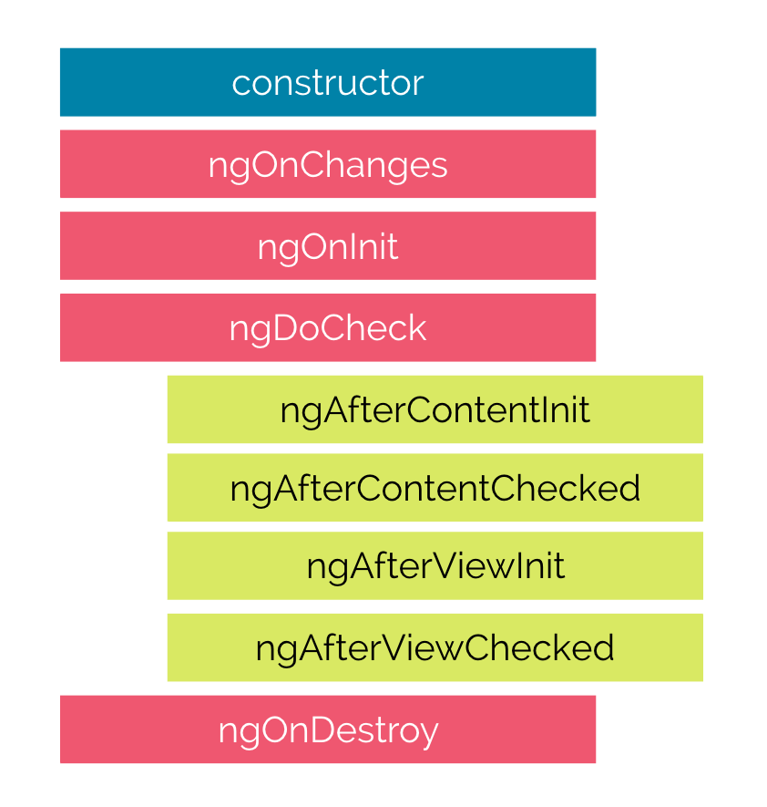

Slide 66
Service
A class with a focused purpose.

Slide 67
Service
A class with a focused purpose.
Independent from any one component

Slide 68
Service
A class with a focused purpose.
Independent from any one component
Provide shared data or logic across components

Slide 69
Service
A class with a focused purpose.
Independent from any one component
Provide shared data or logic across components
Encapsulate external logic (http, etc)

Slide 70
Service
A class with a focused purpose.
Independent from any one component
Provide shared data or logic across components
Encapsulate external logic (http, etc)
Makes components easier to test, debug, and reuse

Slide 71
Dependency Injection
Notes:
In this case, Angular’s injector is the external source which manages all of these services.

Slide 72
Dependency Injection
A design pattern in which a class receives its dependencies from an external source rather than creating them itself.
Notes:
In this case, Angular’s injector is the external source which manages all of these services.

Slide 73
Services
Services are registered as dependencies in providers array of a module in an application

Slide 74
Services
Services are registered as dependencies in providers array of a module in an application
By registering a service in the module, we can let Angular inject it for us in any component or service that uses it as a dependency.

Slide 75
How to build a service
Create a class

Slide 76
How to build a service
Create a class
Use the @Injectable decorator

Slide 77
How to build a service
Create a class
Use the @Injectable decorator
Import any needed files

Slide 78
export class PokemonDataService { public getPokemon(): any[] { } }

Slide 79
@Injectable() export class PokemonDataService { public getPokemon(): any[] { } }

Slide 80
import { Injectable } from ‘@angular/core’
@Injectable() export class PokemonDataService { public getPokemon(): any[] { } }

Slide 82
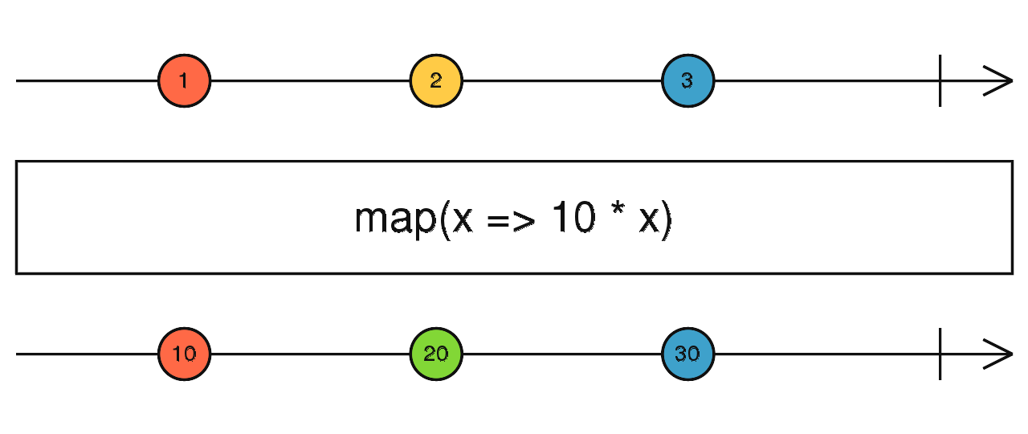
Observables and Reactive Extensions
Treat events as a collection

Slide 83
Observables and Reactive Extensions
Treat events as a collection
Think of them as asynchronous arrays

Slide 84
Observables and Reactive Extensions
Treat events as a collection
Think of them as asynchronous arrays
May eventually make it into JS (stage 1). Use RxJS for now

Slide 85
Promises vs Observables
Promise
Observable

Slide 86
Promises vs Observables
Promise
Provides a single future value
Observable Emits multiple values over time

Slide 87
Promises vs Observables
Promise
Provides a single future value Immediate execution
Observable Emits multiple values over time Lazy

Slide 88
Promises vs Observables
Promise
Provides a single future value Immediate execution Not cancellable
Observable Emits multiple values over time Lazy Cancellable via unsubscribe()

Slide 89
Promises vs Observables
Promise
Provides a single future value Immediate execution Not cancellable No operator support
Observable Emits multiple values over time Lazy Cancellable via unsubscribe() Supports many operators, such as map, filter expand, etc

Slide 90
Wrap Up
Resources and exercises are in these slides.

Slide 91
Resources
Angular docs: https://angular.io/
Angular testing guide: https://angular.io/guide/testing
Angular routing: https://angular.io/guide/router
Change Detection: https://blog.angular-university.io/how-does-angular-2-change-detection-really-work/
Unidirectional Data Flow: https://blog.angular-university.io/angular-2-what-is-unidirectional-data-flow-development-mode/

Slide 92
Resources
My favorite blog on advanced Angular topics: https://blog.angularindepth.com/ Intro to Observables and RxJS: https://gist.github.com/staltz/868e7e9bc2a7b8c1f754 Diagrams for understanding RxJS Operators: https://blog.angularindepth.com/learn-to-combine-rxjs-sequences-with-super-intuitive-interactive-diagrams-20fce8e6511

Slide 93
Additional Exercises
Three tasks to extend the app!

Slide 94
Exercises
Descriptions in APP-Finished.
add_delete_button_description.md
add_nickname_option_description.md add_parallel_requests_description.md
Solutions are in APP-Solutions

Slide 95
THANK YOU!

